Slide 1


Deliberate Attention Networks for Image Captioning
Lianli Gao, kaixuan fan, Jingkuan Song, Xianglong
Liu, Xing Xu, Heng Tao Shen
University of Electronic Science and Technology of China

Slide 2
Outline
Introduction
Related Work
Our Method
Experiments and Results

Slide 3
Outline
Introduction
Related Work
Our Method
Experiments and Results

Slide 4
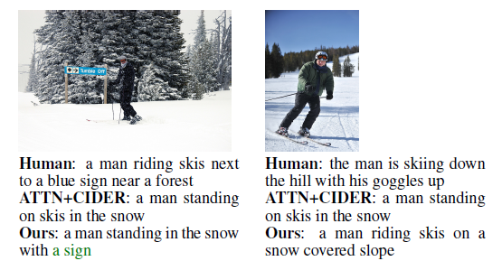
Introduction
Problem Statement
Image Captioning : automatically describing a image in natural language.

Slide 5
Outline
Introduction
Related Work
Our Method
Experiments and Results

Slide 6
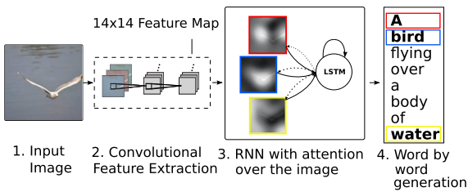
Related Work
Encoder-decoder framework with attention mechanisms for image captioning.
[1] Xu K. , Ba J. et al. " Show, attend and tell: Neural image caption generation with visual attention.“ ICML. 2015.

Slide 7
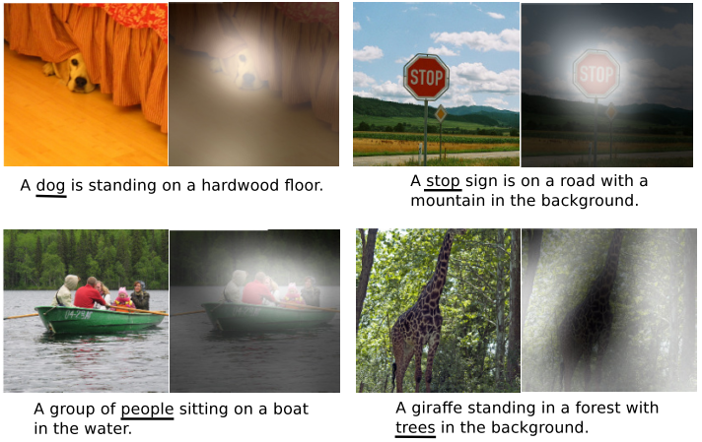
Related Work
Examples of attending to the correct object
[1] Xu K. , Ba J. et al. " Show, attend and tell: Neural image caption generation with visual attention.“ ICML. 2015.

Slide 8
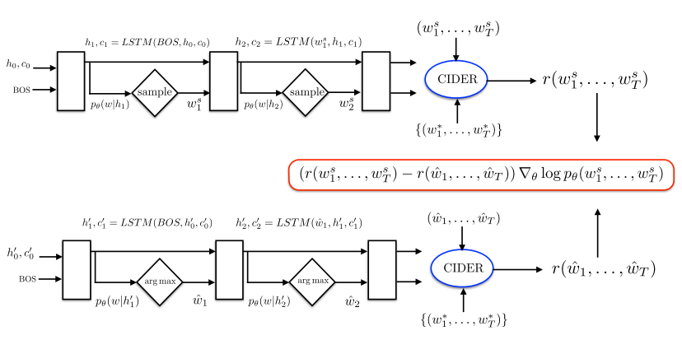
Related Work
Reinforcement learning was used in image captioning.
[1] Rennie S. J. et al. " Self-critical sequence training for image captioning.“ CVPR. 2017.

Slide 9
Outline
Introduction
Related Work
Our Method
Experiments and Results

Slide 10
Our Method
Motivations
We introduce a novel architecture, Deliberate Residual Attention Network for image captioning.
To further generate discriminative sentences, we introduce reinforcement learning to guide the training process of captioning model?
Notes:
[1] M. Grundmann, V. Kwatra, M. Han, and I. Essa. Efficient hierarchical graph-based video segmentation. In CVPR, pages 2141–2148, 2010.
[2] H. Jiang, G. Zhang, H. Wang, and H. Bao. Spatio-temporal video segmentation of static scenes and its applications. IEEE Trans. Multimedia, 17(1):3–15, 2015.
[3] F. Galasso, M. Keuper, T. Brox, and B. Schiele. Spectral graph reduction for efficient image and streaming video segmentation. In CVPR, 2014.
[4] C.-P. Yu, H. Le, G. Zelinsky, and D. Samaras. Efficient video segmentation using parametric graph partitioning. In ICCV, 2015.

Slide 11
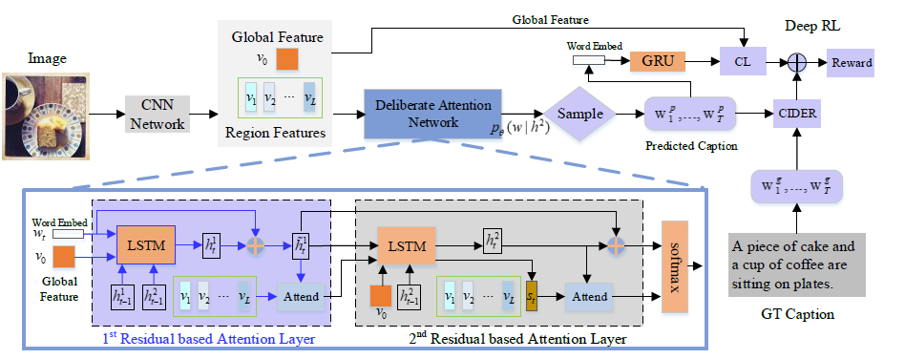
Our Method
Notes:
[1] M. Grundmann, V. Kwatra, M. Han, and I. Essa. Efficient hierarchical graph-based video segmentation. In CVPR, pages 2141–2148, 2010.
[2] H. Jiang, G. Zhang, H. Wang, and H. Bao. Spatio-temporal video segmentation of static scenes and its applications. IEEE Trans. Multimedia, 17(1):3–15, 2015.
[3] F. Galasso, M. Keuper, T. Brox, and B. Schiele. Spectral graph reduction for efficient image and streaming video segmentation. In CVPR, 2014.
[4] C.-P. Yu, H. Le, G. Zelinsky, and D. Samaras. Efficient video segmentation using parametric graph partitioning. In ICCV, 2015.

Slide 12
Our Method
We use pre-trained ResNet-101 to extract global visual feature, and use Faster R-CNN to produce bounding boxes and then apply them on the pre-trained ResNet-101 to extract region features.
Notes:
[1] M. Grundmann, V. Kwatra, M. Han, and I. Essa. Efficient hierarchical graph-based video segmentation. In CVPR, pages 2141–2148, 2010.
[2] H. Jiang, G. Zhang, H. Wang, and H. Bao. Spatio-temporal video segmentation of static scenes and its applications. IEEE Trans. Multimedia, 17(1):3–15, 2015.
[3] F. Galasso, M. Keuper, T. Brox, and B. Schiele. Spectral graph reduction for efficient image and streaming video segmentation. In CVPR, 2014.
[4] C.-P. Yu, H. Le, G. Zelinsky, and D. Samaras. Efficient video segmentation using parametric graph partitioning. In ICCV, 2015.

Slide 13
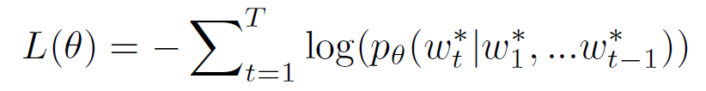

Our Method
MLE Loss :
Where θ are the parameters to be learned. And
represents the ground truth caption.
Notes:
[1] M. Grundmann, V. Kwatra, M. Han, and I. Essa. Efficient hierarchical graph-based video segmentation. In CVPR, pages 2141–2148, 2010.
[2] H. Jiang, G. Zhang, H. Wang, and H. Bao. Spatio-temporal video segmentation of static scenes and its applications. IEEE Trans. Multimedia, 17(1):3–15, 2015.
[3] F. Galasso, M. Keuper, T. Brox, and B. Schiele. Spectral graph reduction for efficient image and streaming video segmentation. In CVPR, 2014.
[4] C.-P. Yu, H. Le, G. Zelinsky, and D. Samaras. Efficient video segmentation using parametric graph partitioning. In ICCV, 2015.

Slide 14
Our Method
Contrastive Loss (CL):
Where , (c, I) indicates that a pair of caption and image is matched. And Both (I, c’) and (I’, c) are mismatched. s(*) is similarity between image and caption.
Notes:
[1] M. Grundmann, V. Kwatra, M. Han, and I. Essa. Efficient hierarchical graph-based video segmentation. In CVPR, pages 2141–2148, 2010.
[2] H. Jiang, G. Zhang, H. Wang, and H. Bao. Spatio-temporal video segmentation of static scenes and its applications. IEEE Trans. Multimedia, 17(1):3–15, 2015.
[3] F. Galasso, M. Keuper, T. Brox, and B. Schiele. Spectral graph reduction for efficient image and streaming video segmentation. In CVPR, 2014.
[4] C.-P. Yu, H. Le, G. Zelinsky, and D. Samaras. Efficient video segmentation using parametric graph partitioning. In ICCV, 2015.

Slide 15
Our Method
Learning (reward function)
Implementation details
We obtain 36 region features for each image. For training process, MLE is firstly used to pre-train the DA model. Next, we train it with reinforcement learning by using CIDEr and CL as reward value.
Where CIDEr is a evaluation metric for image captioning, and $\hat{c}$ is generated caption.
Notes:
[1] M. Grundmann, V. Kwatra, M. Han, and I. Essa. Efficient hierarchical graph-based video segmentation. In CVPR, pages 2141–2148, 2010.
[2] H. Jiang, G. Zhang, H. Wang, and H. Bao. Spatio-temporal video segmentation of static scenes and its applications. IEEE Trans. Multimedia, 17(1):3–15, 2015.
[3] F. Galasso, M. Keuper, T. Brox, and B. Schiele. Spectral graph reduction for efficient image and streaming video segmentation. In CVPR, 2014.
[4] C.-P. Yu, H. Le, G. Zelinsky, and D. Samaras. Efficient video segmentation using parametric graph partitioning. In ICCV, 2015.

Slide 16
Outline
Introduction
Related Work
Our Method
Experiments and Results

Slide 17
Experiments
MSCOCO
It contains 82,783, 40504 and 40775 images for training, validation and testing. And each image has 5 captions annotated by human beings.
Flickr30K
About 31,783 images collected from Flickr, and each image is associated with 5 descriptions.
Notes:
If the task is unspecified as a general video segmentation task, then there is an ambiguity of the correct level of granularity on the ground truth segments, and different human annotators would show different acceptable ways to segment the video. And one can see the agreement among the human annotators are around 80%-90% percent. Especially, they tend to agree on the main subjects but differ on the background ones.
It unifies video and image segmentation benchmark together and allows the testing of coarse-to-fine methods because it
Simple baseline like image segmentation + optical flow actually outperforms all the tested video segmentation methods.

Slide 18
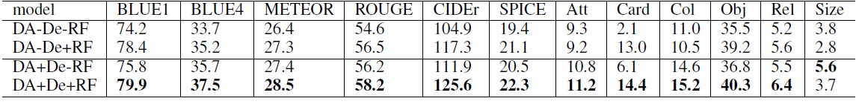
Experiments
Image Ablation study results obtained from the MSCOCO dataset
Notes:
If the task is unspecified as a general video segmentation task, then there is an ambiguity of the correct level of granularity on the ground truth segments, and different human annotators would show different acceptable ways to segment the video. And one can see the agreement among the human annotators are around 80%-90% percent. Especially, they tend to agree on the main subjects but differ on the background ones.
It unifies video and image segmentation benchmark together and allows the testing of coarse-to-fine methods because it
Simple baseline like image segmentation + optical flow actually outperforms all the tested video segmentation methods.

Slide 19
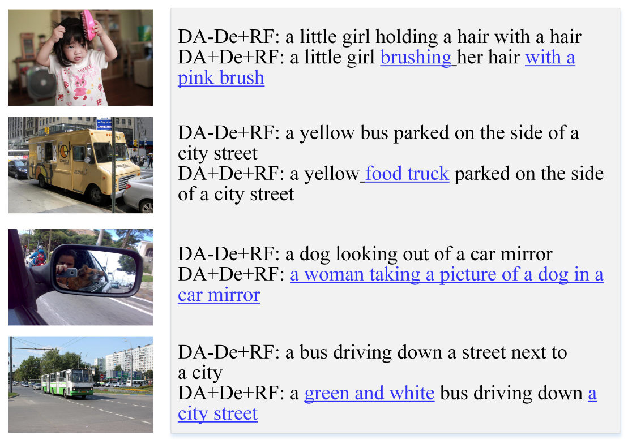
Experiments
Examples of image captions to demonstrate the role of deliberate attention
Notes:
If the task is unspecified as a general video segmentation task, then there is an ambiguity of the correct level of granularity on the ground truth segments, and different human annotators would show different acceptable ways to segment the video. And one can see the agreement among the human annotators are around 80%-90% percent. Especially, they tend to agree on the main subjects but differ on the background ones.
It unifies video and image segmentation benchmark together and allows the testing of coarse-to-fine methods because it
Simple baseline like image segmentation + optical flow actually outperforms all the tested video segmentation methods.

Slide 20
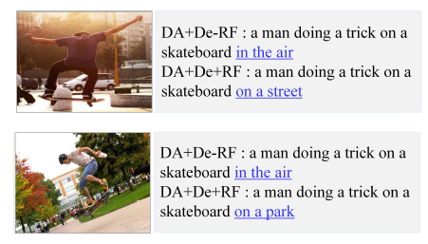
Experiments
Examples of image captions to demonstrate the discriminability
Notes:
If the task is unspecified as a general video segmentation task, then there is an ambiguity of the correct level of granularity on the ground truth segments, and different human annotators would show different acceptable ways to segment the video. And one can see the agreement among the human annotators are around 80%-90% percent. Especially, they tend to agree on the main subjects but differ on the background ones.
It unifies video and image segmentation benchmark together and allows the testing of coarse-to-fine methods because it
Simple baseline like image segmentation + optical flow actually outperforms all the tested video segmentation methods.

Slide 21
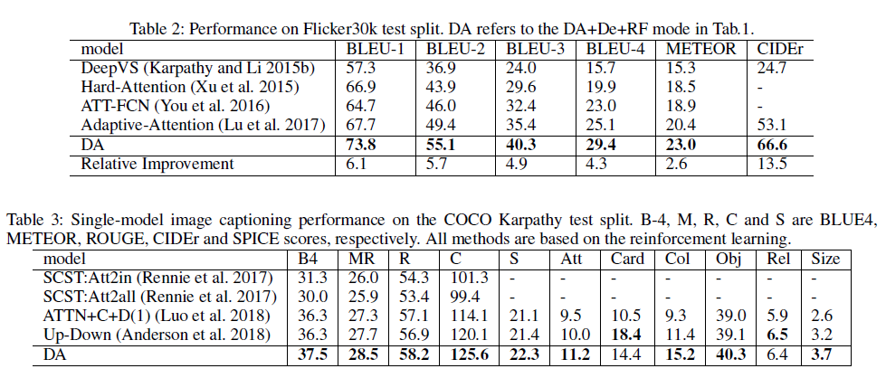
Experiments
Precision Performance on Flickr30k test split and COCO Karpathy test split.
Notes:
If the task is unspecified as a general video segmentation task, then there is an ambiguity of the correct level of granularity on the ground truth segments, and different human annotators would show different acceptable ways to segment the video. And one can see the agreement among the human annotators are around 80%-90% percent. Especially, they tend to agree on the main subjects but differ on the background ones.
It unifies video and image segmentation benchmark together and allows the testing of coarse-to-fine methods because it
Simple baseline like image segmentation + optical flow actually outperforms all the tested video segmentation methods.

Slide 22
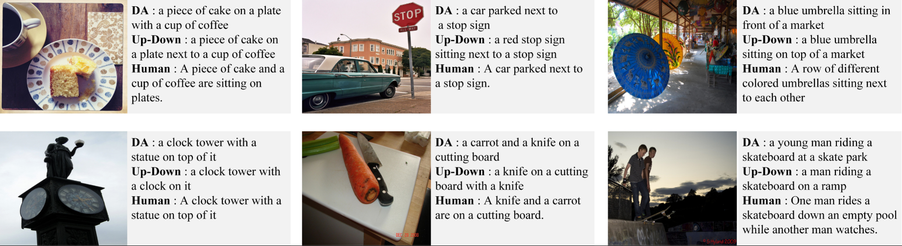
Experiments
Examples of image captions generated by Up-Down, DA and human beings.
[1] Anderson, P. et al. " Bottom-up and top-down attention for image captioning and visual question answering.“ CVPR. 2018.
Notes:
If the task is unspecified as a general video segmentation task, then there is an ambiguity of the correct level of granularity on the ground truth segments, and different human annotators would show different acceptable ways to segment the video. And one can see the agreement among the human annotators are around 80%-90% percent. Especially, they tend to agree on the main subjects but differ on the background ones.
It unifies video and image segmentation benchmark together and allows the testing of coarse-to-fine methods because it
Simple baseline like image segmentation + optical flow actually outperforms all the tested video segmentation methods.

Slide 23
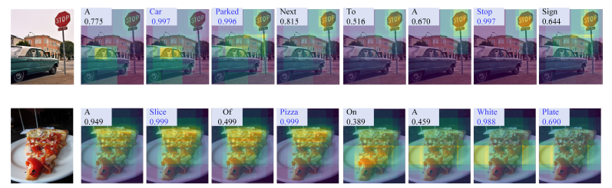
Experiments
Visualization of first residual attention map of our model
Notes:
If the task is unspecified as a general video segmentation task, then there is an ambiguity of the correct level of granularity on the ground truth segments, and different human annotators would show different acceptable ways to segment the video. And one can see the agreement among the human annotators are around 80%-90% percent. Especially, they tend to agree on the main subjects but differ on the background ones.
It unifies video and image segmentation benchmark together and allows the testing of coarse-to-fine methods because it
Simple baseline like image segmentation + optical flow actually outperforms all the tested video segmentation methods.

Slide 24
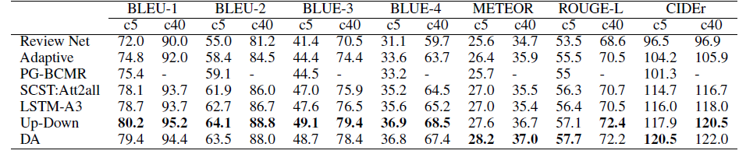
Experiments
Results on the online MSCOCO test server
Notes:
If the task is unspecified as a general video segmentation task, then there is an ambiguity of the correct level of granularity on the ground truth segments, and different human annotators would show different acceptable ways to segment the video. And one can see the agreement among the human annotators are around 80%-90% percent. Especially, they tend to agree on the main subjects but differ on the background ones.
It unifies video and image segmentation benchmark together and allows the testing of coarse-to-fine methods because it
Simple baseline like image segmentation + optical flow actually outperforms all the tested video segmentation methods.

Slide 25
Conclusions
We propose a novel architecture, deliberate residual attention networks (DA) for image captioning.
We guide the process of training with reinforcement learning, by combining CIDEr with CL as reward function.
Experiments on real datasets show that our approach outperforms the state-of-the-art methods.
Notes:
If the task is unspecified as a general video segmentation task, then there is an ambiguity of the correct level of granularity on the ground truth segments, and different human annotators would show different acceptable ways to segment the video. And one can see the agreement among the human annotators are around 80%-90% percent. Especially, they tend to agree on the main subjects but differ on the background ones.
It unifies video and image segmentation benchmark together and allows the testing of coarse-to-fine methods because it
Simple baseline like image segmentation + optical flow actually outperforms all the tested video segmentation methods.

Slide 26
Q&A
Notes:
If the task is unspecified as a general video segmentation task, then there is an ambiguity of the correct level of granularity on the ground truth segments, and different human annotators would show different acceptable ways to segment the video. And one can see the agreement among the human annotators are around 80%-90% percent. Especially, they tend to agree on the main subjects but differ on the background ones.
It unifies video and image segmentation benchmark together and allows the testing of coarse-to-fine methods because it
Simple baseline like image segmentation + optical flow actually outperforms all the tested video segmentation methods.

